Slide 1
IoT Based Smart Parking System
Submitted by:
Aayush Tiwari

Slide 2
Problems Faced
One of the key issues that smart cities relate to are car parking facilities and traffic management systems. In present day cities finding an available parking spot is always difficult for drivers, and it tends to become harder with ever increasing number of private car users.
This situation can be seen as an opportunity for smart cities to undertake actions in order enhance the efficiency their parking resources thus leading to reduction in searching times, traffic congestion and road accidents.
Problems pertaining to parking and traffic congestion can be solved if the drivers can be informed in advance about the availability of parking spaces at and around their intended destination.

Slide 3
Our Solution
At present there are certain parking systems that claim to citizens of delivering real time information about available parking spaces.
Such systems require efficient sensors to be deployed in the parking areas for monitoring the occupancy as well as quick data processing units in order to gain practical insights from data collected over various sources.
The smart parking system that we propose is implemented using a mobile application that is connected to the cloud. The system helps a user know the availability of parking spaces on a real time basis.

Slide 4
With the aim of overcoming the disadvantages of the parking systems mentioned above and some relevant works, we introduce new SPS architecture based on IoT and build a mathematical model of the system operation.
First, our algorithm adopts a mechanism to search car parks at the least cost. Second, we adopt a mechanism for forwarding the vehicles to another car park if the current car park is full.
We propose a network of car parks such that each park is a node in a network. Each node obtains the information from the neighbouring node, thus ensuring smooth movement of vehicles at low cost and increasing the probability of finding a free parking space.

Slide 5
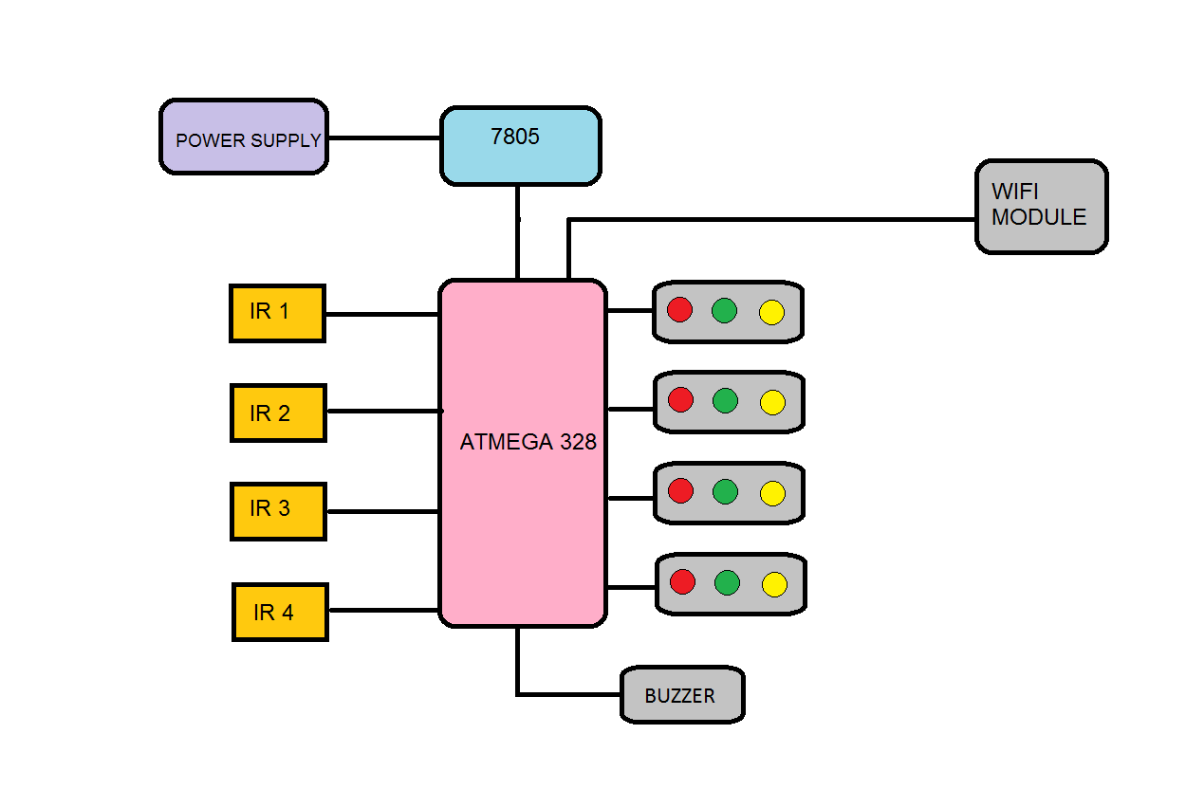
Block Diagram

Slide 6
Smart Parking System Demonstration

Slide 7
Flow Chart

Slide 8
Development Idea
Power supply section
DC adapter /9-12 volt DC battery
Voltage regulator
Input Section
IR Sensor (INFRARED SENSOR)
Controlling section
Arduino Uno
Output section
LEDs: Red, Green and Yellow
Buzzer
WiFi Module ESP8600

Slide 9
Future Scope/Conclusion
The growth of Internet of Things and Cloud technologies have give rise to new possibilities in terms of smart cities. Smart parking facilities and traffic management systems can now be at the core of constructing smart cities. In this paper, we addressed the issue of parking and presented an IoT based Cloud integrated smart parking system. The system that we proposed provides real time information regarding availability of parking slots in a parking area. Users from remote locations can book a parking slot for them by the use of our mobile application. The efforts made in this paper are indented to improve the parking facilities of a city and thereby aiming to enhance the quality of life of its people.

Slide 10
References and Bibliography
https://www.researchgate.net/publication/303842610_IoT_based_Smart_Parking_System
[1] Rico, J., Sancho, J., Cendon, B., & Camus, M. (2013, March). Parking easier by using context information of a smart city: Enabling fast search and management of parking resources. In Advanced Information Networking and Applications Workshops (WAINA), 2013 27th International Conference on (pp. 1380-1385). IEEE.
[2] Zheng, Y., Rajasegarar, S., & Leckie, C. (2015, April). Parking availability prediction for sensor-enabled car parks in smart cities. In Intelligent Sensors, Sensor Networks and Information Processing (ISSNIP), 2015 IEEE Tenth International Conference on (pp. 1-6). IEEE.
[3] Zhou, F., & Li, Q. (2014, November). Parking Guidance System Based
on ZigBee and Geomagnetic Sensor Technology. In Distributed
Computing and Applications to Business, Engineering and Science

Slide 11


